Slide 1


Slide 2
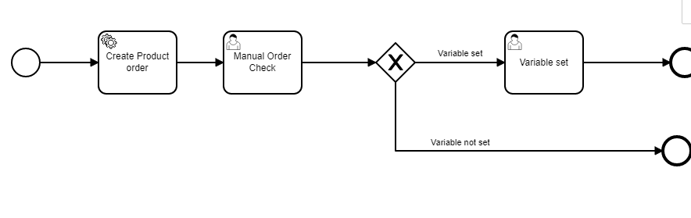
Camunda —BPM Engine

Slide 3
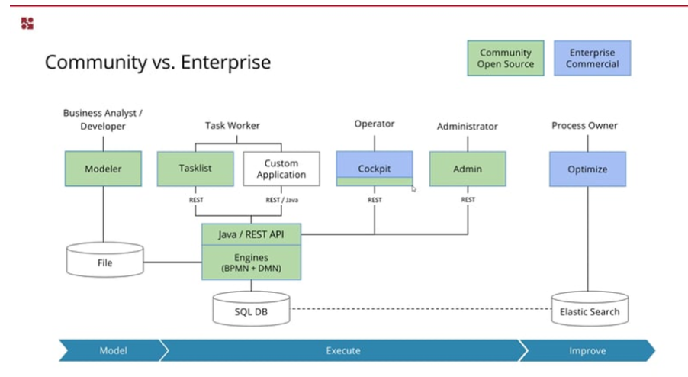
Components

Slide 4
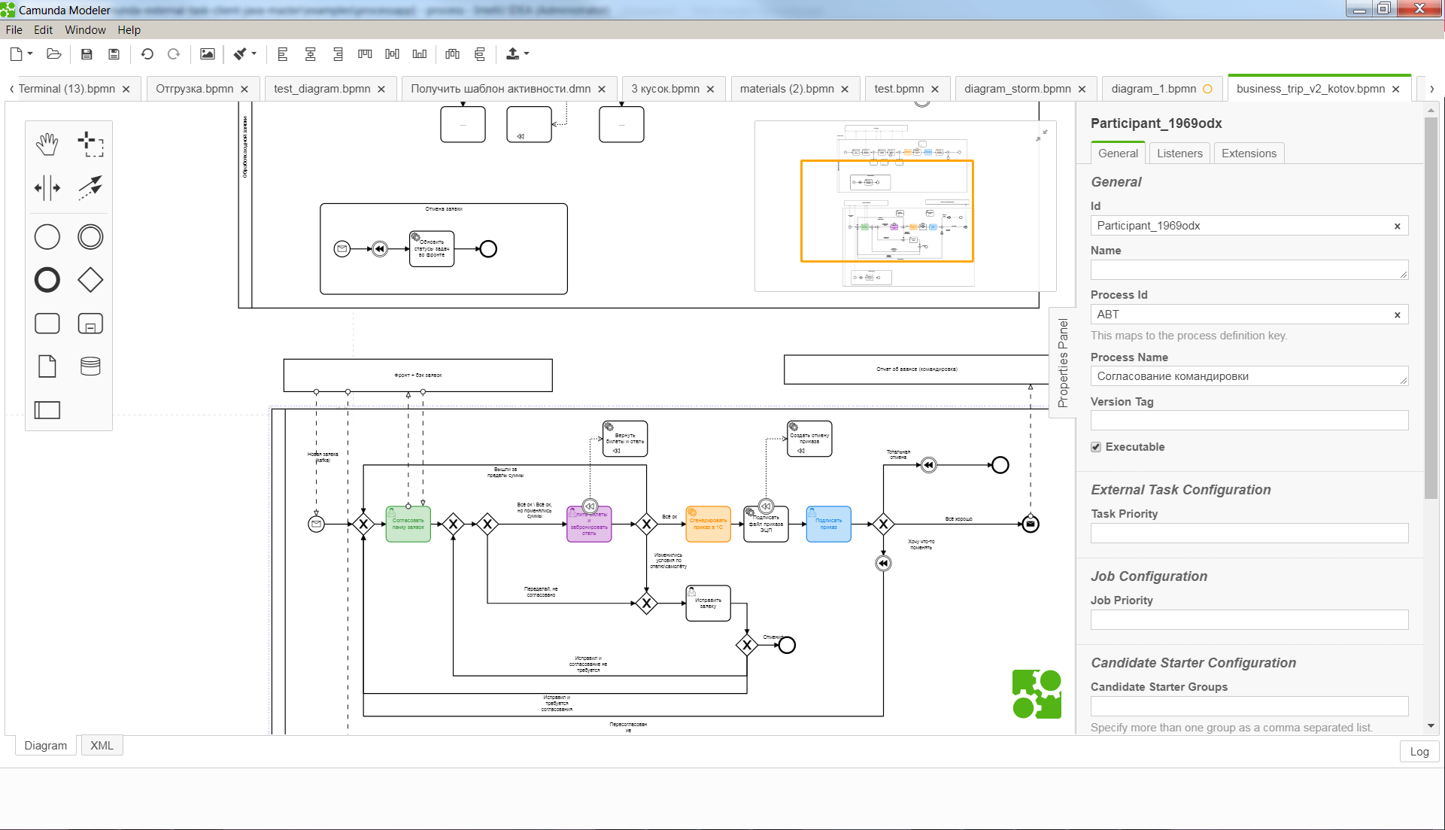
Modeler

Slide 5
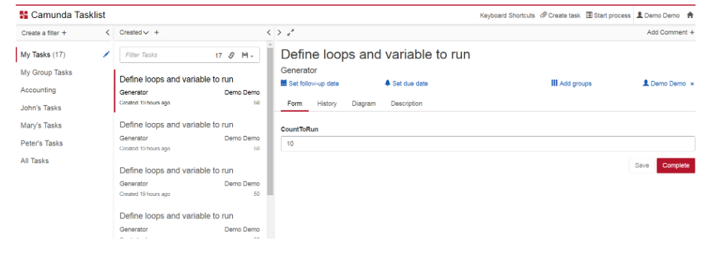
Task list

Slide 6
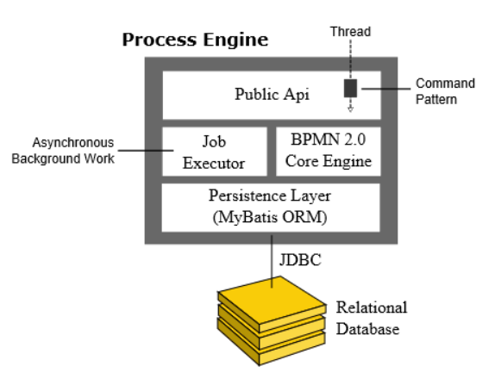
BPMN Engine

Slide 7
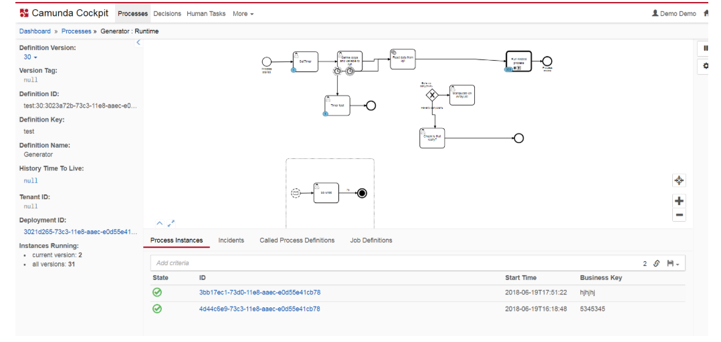
Cockpit

Slide 8
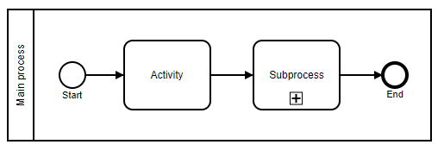
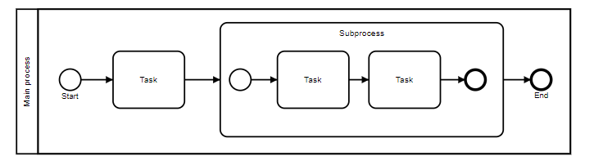
Embedded Subprocess

Slide 9
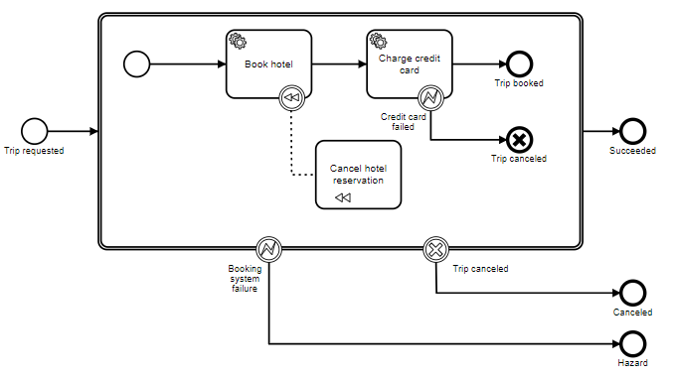
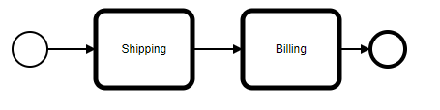
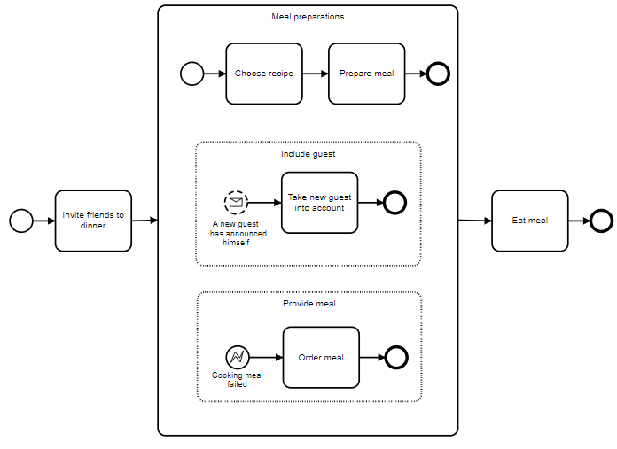
Call Activity, Event Subprocess, Transaction Subprocess

Slide 10
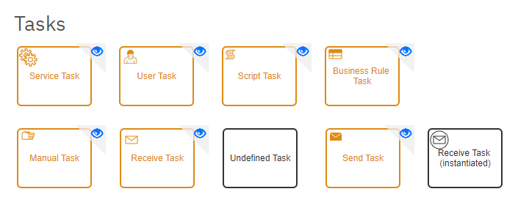
Tasks

Slide 11
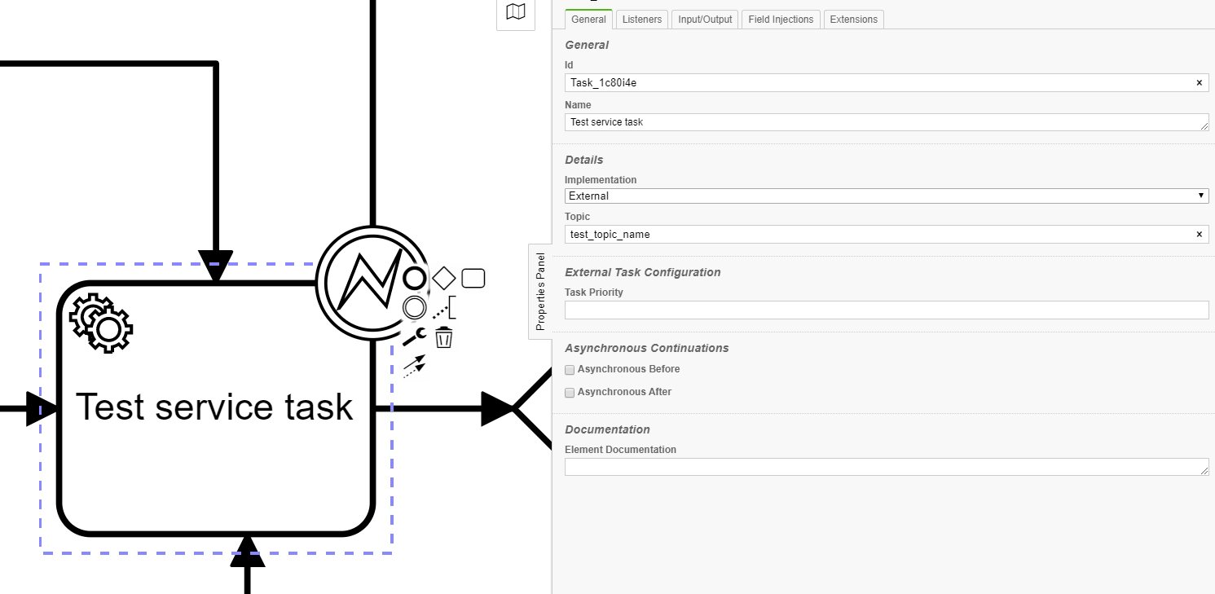
Service task example
@Slf4j @Component @ExternalTaskHandlerAnnotation(topicName = “test_topic_name", lockDuration = 300) public class ClassHandler extends AbstractHandlerWithBusinessInstanceSupport { @Override public void execute(ExternalTask task, ExternalTaskService service, BusinessInstanceDTO instance) throws Exception { Map<String, Object> vars = new HashMap<>();
(……………… some business logic) vars.put(“Key1", Boolean.TRUE); vars.put(“Key2", “Some string value"); service.complete(task, vars);
}
}

Slide 12
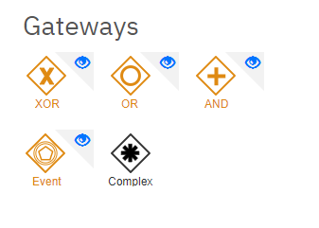

Slide 13
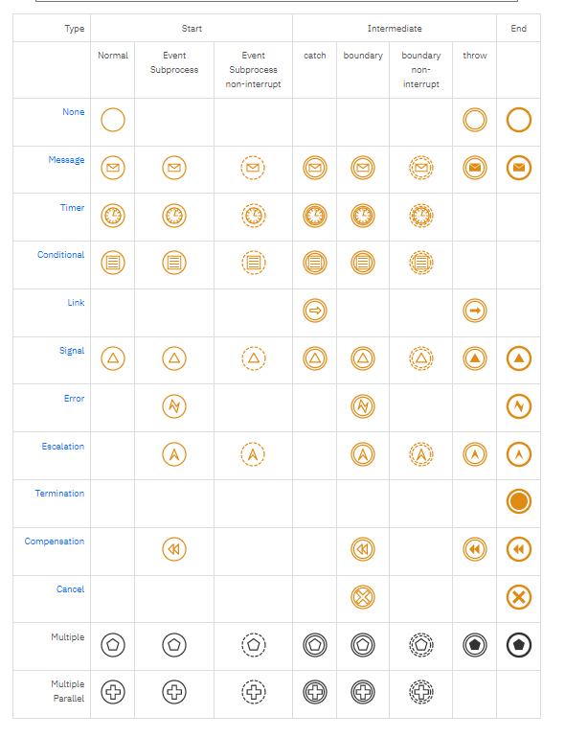
Events

Slide 14
URLs:
https://www.youtube.com/watch?v=sgcSm7YneTs&list=PLJG25HlmvsOVssaiPmavxv3htN_dXS3BW
https://www.youtube.com/watch?v=l-sCUKQZ44s&list=PLJG25HlmvsOUnCziyJBWzcNh7RM5quTmv

